Slide 1



Cricket World Cup Analysis From 2013 to 2019
View in Power BI
Last data refresh:
19/05/2024 23:35:46 UTC
Downloaded at:
19/05/2024 23:39:32 UTC

Slide 2
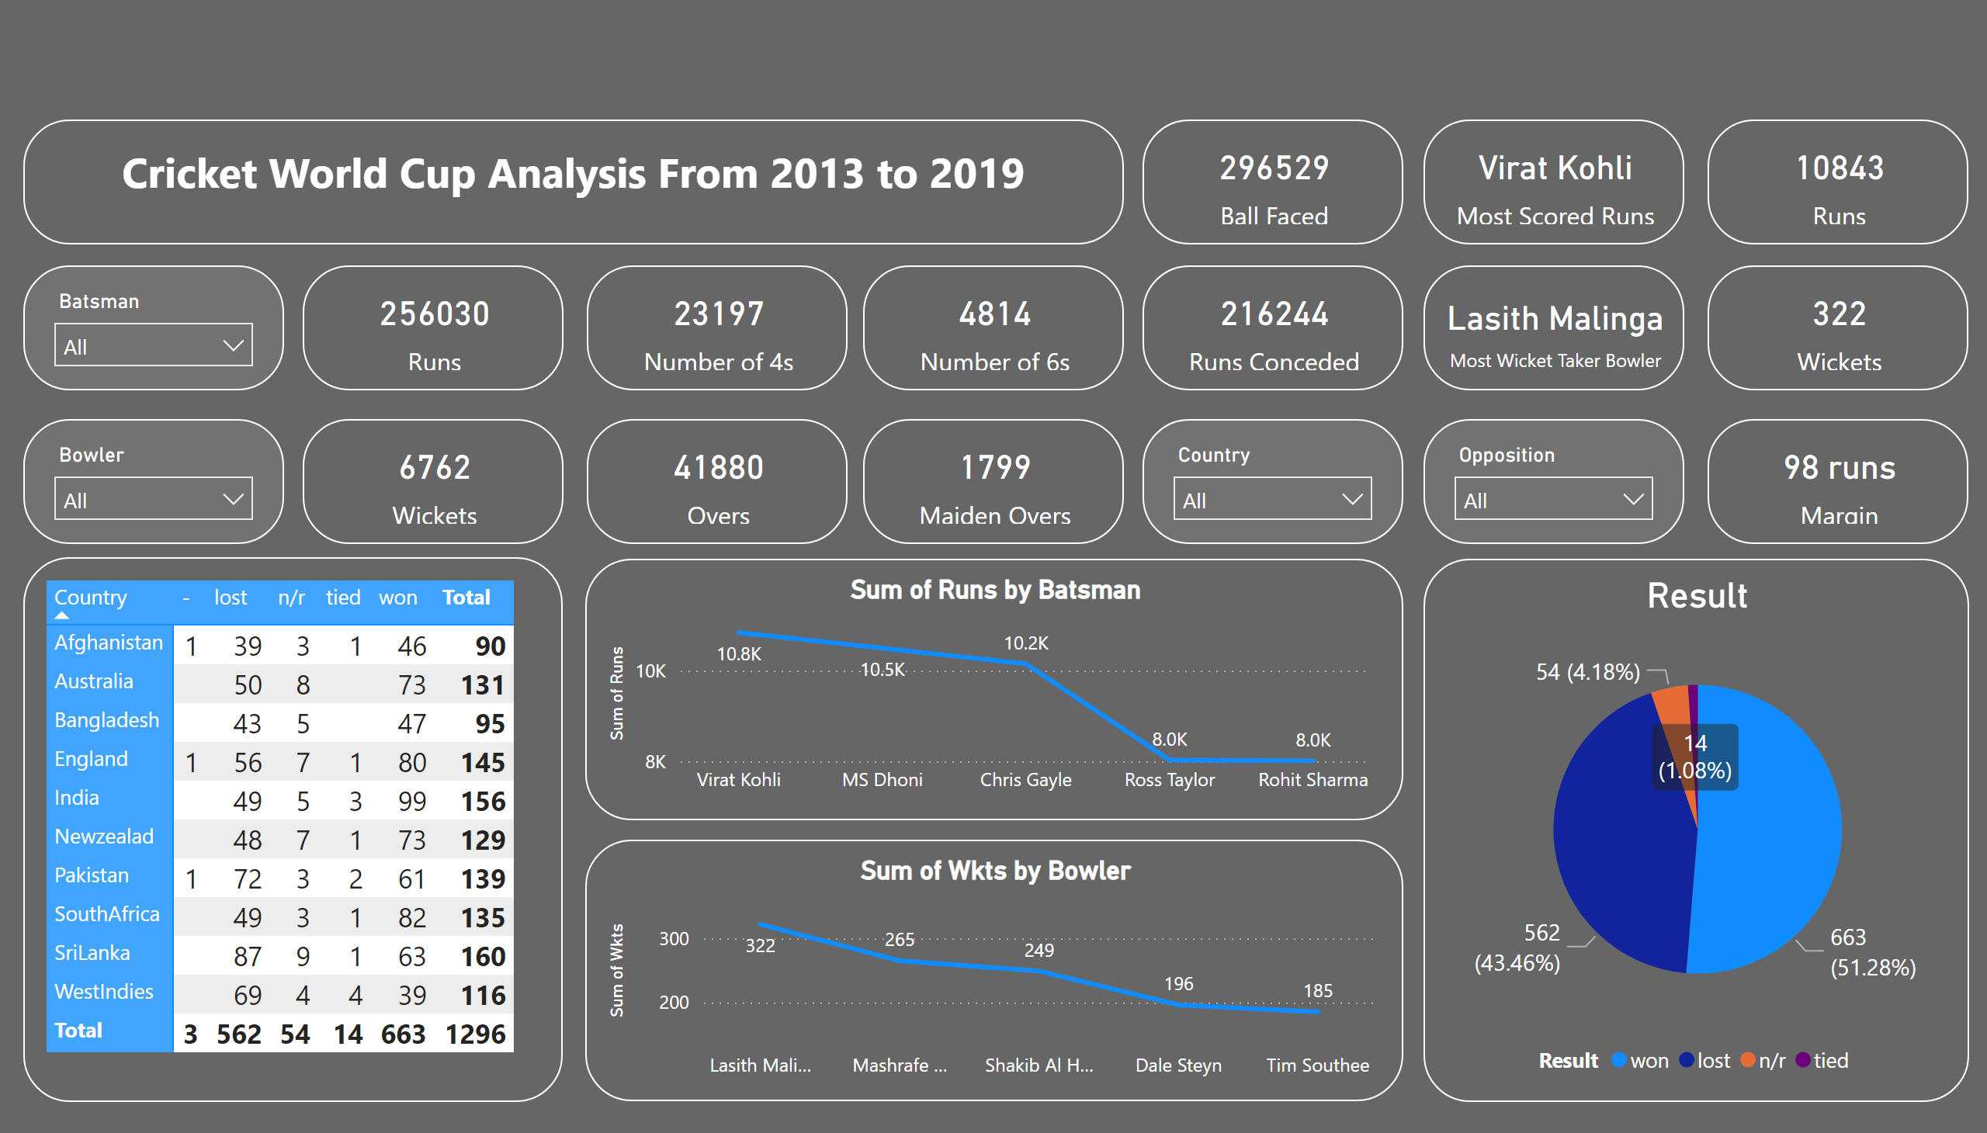
Page 1
Notes:
slicer
No alt text provided
card
No alt text provided
card
No alt text provided
card
No alt text provided
card
No alt text provided
Most Scored runs
No alt text provided
Most Scored runs
No alt text provided
slicer
No alt text provided
card
No alt text provided
card
No alt text provided
card
No alt text provided
card
No alt text provided
card
No alt text provided
card
No alt text provided
slicer
No alt text provided
slicer
No alt text provided
Result
No alt text provided
card
No alt text provided
pivotTable
No alt text provided
lineChart
No alt text provided
lineChart
No alt text provided
textbox
No alt text provided

